Slide 1
Geometry and Image Based Rendering: A Review

Slide 2
Outline
Rendering
Rendering Techniques
Comparison
Conclusion

Slide 3
Rendering
What is rendering?
Rendering is the process of producing realistic images from either 3D geometry of the scene or from the set of images.
First method is known as Geometry based rendering and later is called as Image based rendering
Application of rendering?
Multi-media games
Architecture Model design
Walk-through simulation
Animation generation
Sports activity simulation

Slide 4
Rendering Techniques
Geometry based rendering
Image based rendering
Point based rendering

Slide 5
Geometry Based rendering
It is the process of generating an image from a Model by means of software programs
The model is a description of Three dimensional objects in a strictly defined language or data structures. It would contain Geometry ,viewpoint, texture and lighting information
Traditional Geometry based rendering methods used triangles as primitive which makes rendering complexity dependent on the model to be rendered.

Slide 6
Issues in Geometry Based Rendering
Geometry based rendering is good for large objects of reasonable complexity but they become somewhat inefficient at representing objects with high level of details.
Considerable overhead is introduced with the conventional polygon based rendering as soon as the polygonal rendering primitives get smaller than a pixel on the screen
Rendering complexity is dependent on the model to be rendered
Challenge
Render complex object in real time without the use of expensive hardware

Slide 7
Geometry based rendering:
Geometry based rendering consisting of six basic steps
Geometry
Camera : viewing specification
Lights
Surface characteristics :Diffuse and specular reflection
Shading algorithm :Shading algorithm calculates color at each pixel of the surface .Smooth shading is used, in which shading information is computed for each polygon vertex and interpolated across the polygons to determine the shading at each pixel.
Two types of interpolated shading model
  Gouraud shading
  Phong shading
  Rendering algorithm : use shading algorithm with visible surface determination

Slide 8
More realism can be added
shadow effect,
texture mapping
light bounces from the neighboring surfaces along with the normal illumination of direct lights
(global illumination)

Slide 9
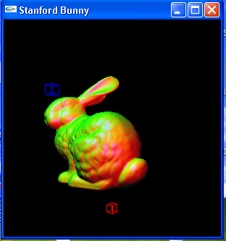

Slide 10
Image based Rendering
Realistic image is produced from set of given images
Rendering cost is proportional to the number of pixels in the image rather than to scene complexity. So it is faster compared to geometry based rendering
Drawbacks
Large memory requirements
Noticeable artifacts from many viewing directions
Cannot handle dynamic lighting

Slide 11
Image based Rendering
It use pre rendered images of the scene as the basic primitives to render a scene So it is possible to achieve higher level of realism in real time
Image based rendering techniques are classified based on how many input images are needed and how much geometry information is required
The classical rendering pipeline can be shown as under
Scene description
Camera Transformation
Rendering
Image
Scene description
Plenoptic function
Sample
Image

Slide 12
Image based Rendering
From the scene description (shape and illumination) we compute the plenoptic function
The plenoptic function describes the complete flow of light on each direction of the space from any point of view
A parameterization of the plenoptic function is given by p=p(θ, Ø, x, y, z) which computes the radiant energy from the point O (x, y, z) in the direction (θ, Ø) ,longitude and latitude angles on a sphere of radius 1 with centre O (x, y, z)
A complete sample of the scene is known as environment map
After plenoptic function we sample the plenoptic function to obtain image for a differed specification of viewing parameters

Slide 13
Image Based Rendering
The problem with this traditional pipeline is we need to model the scene objects and the illumination to compute the plenoptic function ,which is a difficult task
So we required image based rendering which is shown as under
Screen Description
Sampled Plenoptic Function
Continuous Plenoptic Function
Continuous plenoptic function
Sample
Image

Slide 14
Image Based Rendering
Image based rendering involves three processes: sample ,reconstruct and sample again
The samples of the plenoptic function in the first part of the pipeline can be obtained from a virtual environment or from real scenes using camera, scanners etc
The two parts of the pipeline can be decoupled that is the first part can be a preprocessing step, while the second part is executed in real time

Slide 15
Classification of Image Based rendering
Image Based Rendering can be classified into three categories according to how much geometry information is used
1 Rendering without geometry
2 Rendering with implicit geometry
3 Rendering with explicit geometry

Slide 16
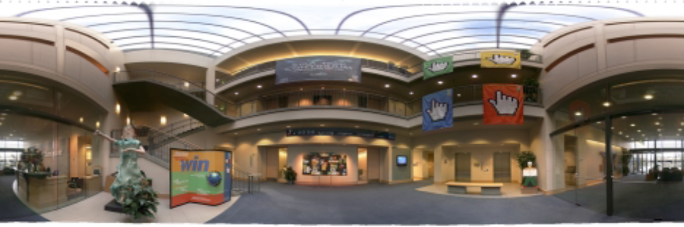
Image based rendering techniques
1 Image based rendering with no Geometry
Image Mosacing
It can be created by taking a bunch of pictures around one place and then stitching them together to from a composite image.
The resulting panoramic image will enable the human to view the environment up to 360 degress.
2 Rendering with implicit geometry
View Morphing
It reconstructs any viewpoint on the line linking two optical centers of the original cameras from two input images.

Slide 17
3 Rendering with explicit geometry
3D wrapping
When the depth information is available for every point in one or more images, this techniques can be used to render nearly all viewpoints
It project all the pixels of the original image to their proper 3D locations and re- projecting them onto the new picture

Slide 18
What is point based rendering ?
Point-based rendering is a new rendering method that uses sample points from surface models as display primitives.
OR
Using points as the rendering primitives, surfaces are constructed from a cloud of points and this is known as Point-Based Rendering.
It utilizes the point samples that are acquired from either 3D range scanners or 3D models represented in file
In comparison to conventional image based rendering methods , these point samples contain additional geometric information and that are view independent

Slide 19
Challenges in PBR
No connectivity information
Efficient method is required for representation of point samples, project the samples into the screen and reconstruct continuous surfaces without holes on the screen in real time
Advantages
It combine advantages of both the method
It achieves speed of image based rendering methods with quality , flexibility and compactness same as Geometry based Rendering

Slide 20
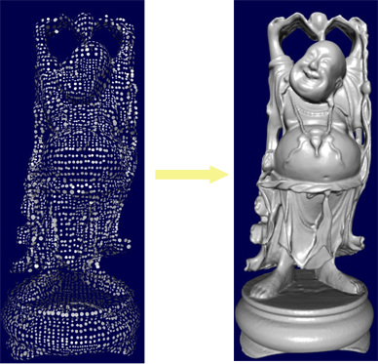
Input – Output of PBR System
Input → Point Clouds
Output → Image

Slide 21
Point based rendering Technique
Point rendering algorithms can be classified according to how they construct the surfaces from the samples used .Following four different approaches have been proposed
1 Hole detection and filling in screen-space : Individual samples are projected on the screen and the pixels not receiving samples are detected. The surface is then interpolated from the neighboring samples
2 Generating more samples : a surface is adaptively interpolated in object-space to guarantee that every pixel receives at least one sample
3 Splatting : A surface sample is projected on the screen and its contribution is spread into the neighboring pixels to guarantee coverage. Higher quality methods average the contributions of all splats contributing to the pixel
4 Meshing : a polygon mesh is used for interpolating the surface samples

Slide 22
Literature Review of PBR
Levoy and Whitte note that the display of scenes containing a high level of image complexity, particularly those in which the number of polygons approaches or exceeds the number of pixels on the screen the coherence provided by rendering polygons or other higher level primitives become less beneficial
Surface reconstruction is done by estimating the converge by the number of points projecting to an area of a filter kernel at each pixel

Slide 23
Literature Review of PBR
Grossman and Dally proposed a point sample rendering technique
They have used first approach i.e Hole detection and filling
When a pixel is hit by points from multiple surfaces a Z-buffer can be used to resolve visibility
However it does not employ a multi resolution approach but only a constant sampling density. Thus, it is only efficient for a limited range of viewing distances

Slide 24
Point based rendering Technique
In 2000 by Rusinkiewciz and Levoy developed a realtime rendering system called QSplat to rendered complex models acquired from 3D scanners
QSplat: QSplat is a point-based rendering system that uses the visibility culling, Level of detail (LOD) control, and geometric compression to render very large triangular meshes.
This technique stores the geometric information of an object to be render into hierarchical manner: (Octree)
QSplat uses a pre-computed bounding sphere hierarchy that performs a hierarchical clustering of points

Slide 25
Preprocessing Algorithm
The algorithm builds up the tree by splitting the set of vertices along the longest axis of its bounding box , recursively computing the two sub trees and finding the bounding sphere of the two children spheres
When then recursion reaches a single vertex , we simply create a sphere whose centre is the position of the vertex
BuildTree(vertices[begin..end])
{
if (begin == end)
return Sphere(vertices[begin])
else
midpoint = PartitionAlongLongestAxis(vertices[begin..end])
leftsubtree = BuildTree(vertices[begin..midpoint])
rightsubtree = BuildTree(vertices[midpoint+1..end])
return BoundingSphere(leftsubtree, rightsubtree)
}

Slide 26
Once the hierarchy has been constructed, the following algorithm is used for display:
Rendering Algorithm
        TraverseHierarchy(node)
        {
        if (node not visible) // Back face culling
        skip this branch of the tree
        else if (node is a leaf node)
        draw a splat
        else if (benefit of recursing further is too low)
        draw a splat
        else
        for each child in children(node)
        TraverseHierarchy(child) }

Slide 27
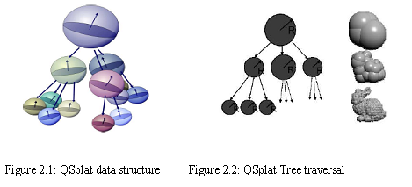

Slide 28
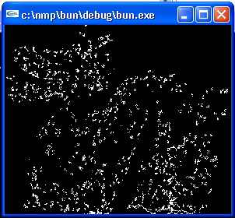

Slide 29
Conclusion
Image based rendering is expensive in terms of acquiring and storing the database while in geometry based rendering compactness may be achieved at the cost of output visual quality
In image based rendering ,rendering complexity is not dependent on the complexity of the scene but dependent on the resolution of images while in geometry based it is dependent on the scene complexity
Point based rendering achieves speed and compactness both
Given a large data set Qsplat method guarantees high quality rendering
But if the given input model is not enough sampled then this might not give good results
Qsplat method do not solve the problem of aliasing

Slide 30
References
Heung-Yeung Shum and Sing Bing Kang A Review of Image-based Rendering Techniques. In IEEE/SPIE Visual communications and Image Processing (VCIP) pages 2-13.
Szymon Rusinkiewicz and Marc Levoy QSplat : A multiresolution point rendering system for large meshes, proceedings of SIGGRAPH 2000 ,343-352
Jonas gomes ,lucia darsa,Bruno Costa,Luiz Velho Wrapping and Morphing of Graphical objects, Morgan Kaufmann Publishers
http://www.cc.gatech.edu/projects/large_models/ply.html
P. E. Debevec, C. J. Taylor, and J. Malik. Modeling and rendering architecture from photographs: A hybrid geometry- and image-based approach. Computer Graphics (SIGGRAPH’96), pages 11–20, August 1996.

Slide 31
THANK YOU

